Slide 1
Usability Testing in the Context of UX Research Methods
Week 2

Slide 2
Recap
In Week 1
  We looked at the key concepts of usability testing
  We clarified terminology used interchangeably
Looked at usability metrics
  This week we will look at User Experience Research Methods and Usability Testing specifically

Slide 3
What makes something useful?
“the user can do what he or she wants to do the way he or she expects to be able to do it, without hindrance, hesitation, or questions.”
“absence of frustration”
Rubin, J. & Chisnell, D. (2008) Handbook of usability testing: how to plan, design, and conduct effective tests, second edition. 2nd ed. Indianapolis, Ind: Wiley. (.p 3)
utility
usability
useful
?

Slide 4
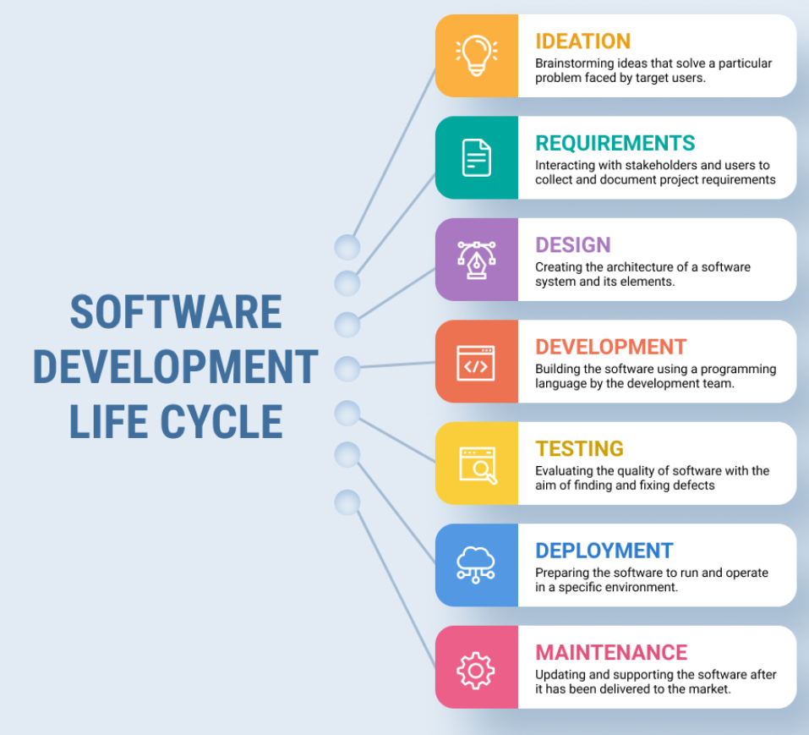
When should I do user research on my project?
right now
all the stages
early in the project
what can go wrong in this process so that a digital product may not be easy to use?
(SDLC)
Notes:
User research can be done at any point in the design cycle.
User-experience research methods are great at producing data and insights, while ongoing activities help get the right things done. Alongside R&D, ongoing UX activities can make everyone’s efforts more effective and valuable. At every stage in the design process, different UX methods can keep product-development efforts on the right track, in agreement with true user needs and not imaginary ones.
However, what can go wrong in this process so that a digital product may not be easy to use?
One of the questions we get the most is, “When should I do user research on my project?” There are three different answers:
Do user research at whatever stage you’re in right now. The earlier the research, the more impact the findings will have on your product, and by definition, the earliest you can do something on your current project (absent a time machine) is today.
Do user research at all the stages. As we show below, there’s something useful to learn in every single stage of any reasonable project plan, and each research step will increase the value of your product by more than the cost of the research.
Do most user research early in the project (when it’ll have the most impact), but conserve some budget for a smaller amount of supplementary research later in the project. This advice applies in the common case that you can’t get budget for all the research steps that would be useful.

Slide 5
Why products are hard to use?
Development focuses on the machine or system
Target audience change and adapt
Team specialists don’t always work in integrated ways
Design and implementation don’t always match
Designing usable products is difficult
?
Somebody
Human
Someplace
Context
Something
Activity
Bailey’s human
performance model
Notes:
what can go wrong in this process so that a digital product may not be easy to use?
There are three major components to consider in any type of human performance situation as shown in Bailey's Human performance model.
The human
The context
The activity
Because the development of a system or product is an attempt to improve human performance in some area, designers should consider these three components during the design process. All three affect the final outcome of how well humans ultimately perform. Unfortunately, of these three components, designers, engineers, and programmers have traditionally placed the greatest emphasis on the activity component, and much less emphasis on the human and the context components. The relationship of the three components to each other has also been neglected. There are several explanations for this unbalanced approach:
There has been an underlying assumption that because humans are so inherently flexible and adaptable, it is easier to let them adapt themselves to the machine, rather than vice versa.
Developers traditionally have been more comfortable working with the seemingly "black and white," scientific, concrete issues associated with systems, than with the more gray, muddled, ambiguous issues associated with human beings.
Developers have historically been hired and rewarded not for their interpersonal, "people" skills but for their ability to solve technical problems.
The most important factor leading to the neglect of human needs has been that in the past, designers were developing products for end users who were much like themselves. There was simply no reason to study such a familiar colleague. That leads us to the next point.

Slide 6
What makes products more usable
User Centred Design (UCD) represents the techniques, processes, methods and procedures for designing products and systems by placing the user at the centre of the process
Emphasis is placed in the 3 following elements of UCD:
Research
It begins with research to understand the user, their objectives and contexts
Evaluation and measurement of product usage
Iteration
Uses an iterative process that allows for constant evaluation and improvement
Notes:
User Centred Design (UCD) represents the techniques, processes, methods and procedures for designing usable products and systems, it is the philosophy of placing the user at the centre of the process
The UCD development starts with putting the user in the centre
Emphasis is placed in the 3 following elements of UCD:
Early focus on the user and their tasks
Evaluation and measurement of product usage
Iterated design

Slide 7
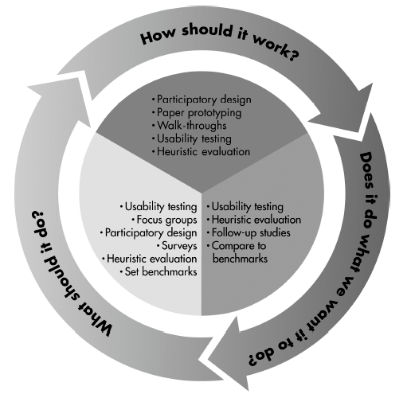
UCD involves
Receiving user feedback or input during each phase of the SDLC, or prior to moving to the next phase
This can include a variety of techniques

Slide 8
What do we measure?
What do we measure with usability testing?
What makes a product useful?
When a product has good usability?
?

Slide 9
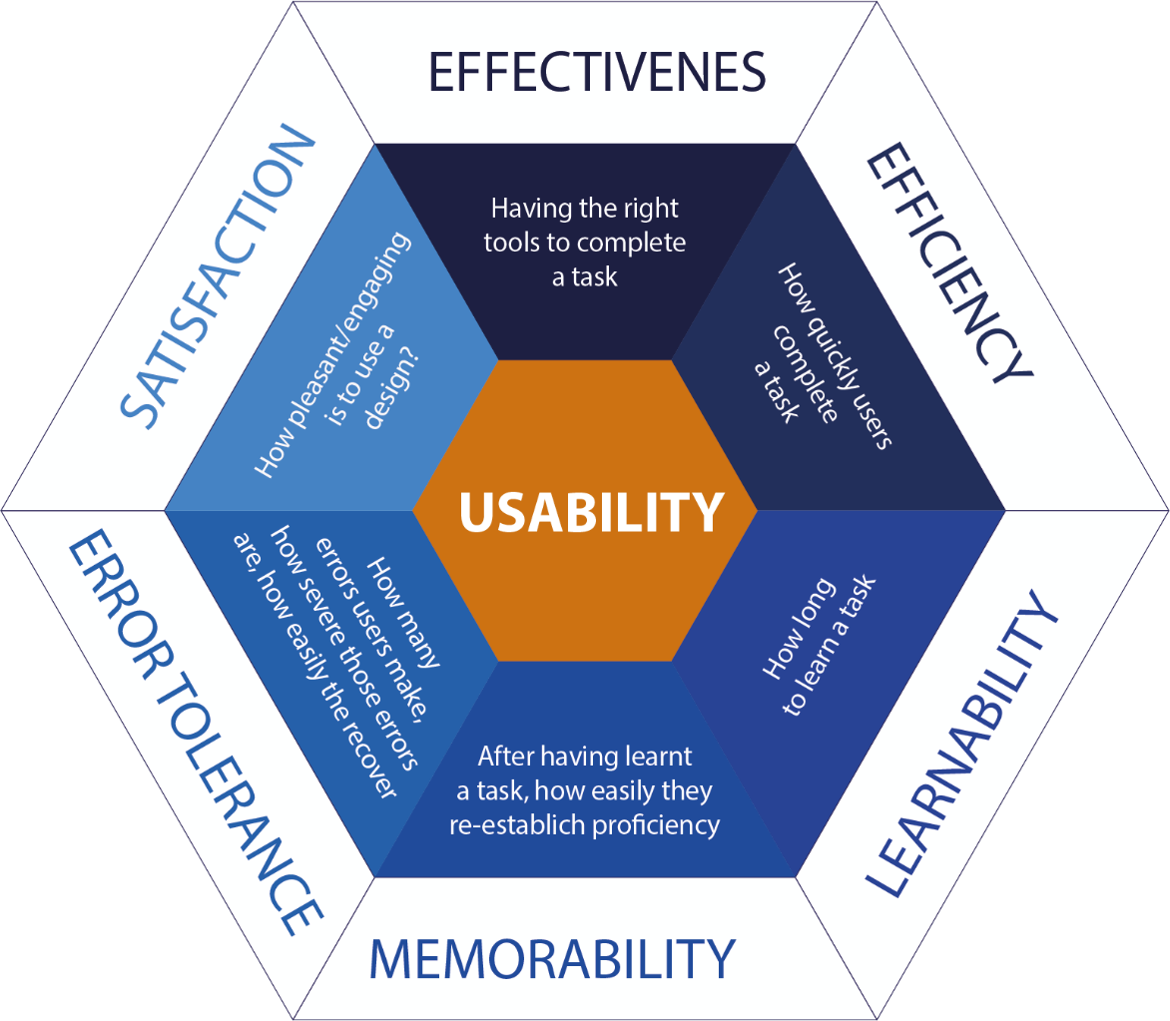

What do we test and measure? Usability metrics
Preference & Emotions
Performance
Attitudinal
Behavioural
What do we measure?
Metric
A way of measuring and evaluating a particular phenomenon or item

Slide 10
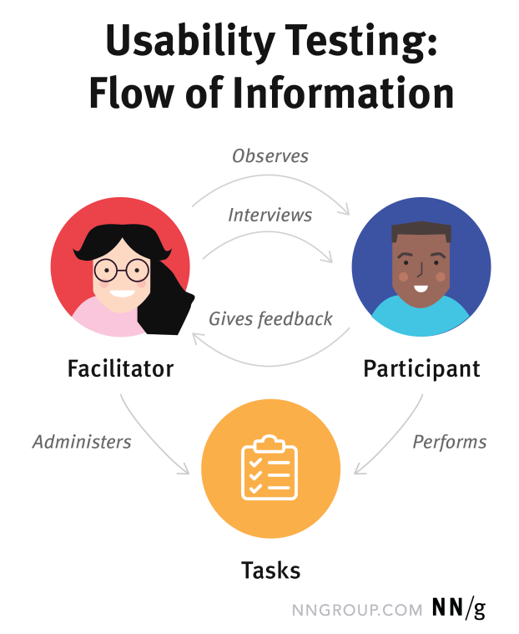
Core elements of usability testing
?
Notes:
Facilitator
The facilitator guides the participant through the test process. She gives instructions, answers the participant’s questions, and asks followup questions.
The facilitator works to ensure that the test results in high-quality, valid data, without accidentally influencing the participant’s behavior. Achieving this balance is difficult and requires training.
(In one form of remote usability testing, called remote unmoderated testing, an application may perform some of the facilitator’s roles.)
Tasks
The tasks in a usability test are realistic activities that the participant might perform in real life. They can be very specific or very open-ended, depending on the research questions and the type of usability testing.
Examples of tasks from real usability studies:
Your printer is showing “Error 5200”. How can you get rid of the error message?
You're considering opening a new credit card with Wells Fargo. Please visit wellsfargo.com and decide which credit card you might want to open, if any.
You’ve been told you need to speak to Tyler Smith from the Project Management department. Use the intranet to find out where they are located. Tell the researcher your answer.
Task wording is very important in usability testing. Small errors in the phrasing of a task can cause the participant to misunderstand what they’re asked to do or can influence how participants perform the task (a psychological phenomenon called priming).
Task instructions can be delivered to the participant verbally (the facilitator might read them) or can be handed to a participant written on task sheets. We often ask participants to read the task instructions out loud. This helps ensure that the participant reads the instructions completely, and helps the researchers with their notetaking, because they always know which task the user is performing.
Participant
The participant should be a realistic user of the product or service being studied. That might mean that the user is already using the product or service in real life. Alternatively, in some cases, the participant might just have a similar background to the target user group, or might have the same needs, even if he isn’t already a user of the product.
Participants are often asked to think out loud during usability testing (called the “think-aloud method”). The facilitator might ask the participants to narrate their actions and thoughts as they perform tasks. The goal of this approach is to understand participants’ behaviors, goals, thoughts, and motivations.

Slide 11





How to we measure usability?
What do we need? prototype, test material
Who is involved? facilitator, user
What are their roles? to conduct the test, to be observed

Slide 12
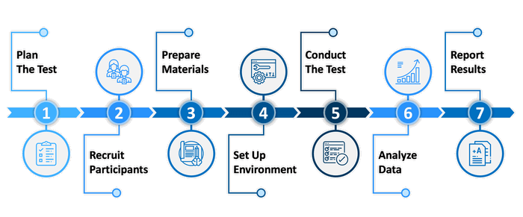
What is involved in usability testing
We will cover this in week3
Notes:
1. Planning the usability test
This stage should output a document describing the test’s goals and methodology, how the team will choose participants, what the working procedure will be, the types of data the team wants to collect, and the like.
2. Recruiting participants
This stage includes deciding who your ideal participants will be, developing a detailed recruiting questionnaire, and determining a plan of action to begin seeking and evaluating participants.
3. Preparing test materials
Test materials prep helps you to decide what actions you’ll want participants to take within your product, and the types of outcome you’re working toward. Then you will need to design the test environment (which could be remote or in-person at your offices).
4. Setting up the test environment
For this stage, you will need to design the actual environment where you will be conducting your tests. Usability test methods include lab testing (in-person at your offices) and remote testing (where participants can log in to your test from anywhere). You will need to choose which type of test makes sense for your team’s goals and needs.
5. Conducting the test
Here you will run your usability test with your participants. One tip offered in the IEEE paper is to conduct dry-run tests beforehand with your team. Dry-run tests are a good way to learn ahead of time if there will be any problems in collecting and recording data. It is also an opportunity to uncover any issues with your product before your participants do.
Here are two additional usability testing steps:
6. Analyzing the data
Here your team will study all data gathered from your usability test to glean critical insights and actionable intelligence on how to improve your product’s usability.
7. Reporting the results
Finally, you will share your usability tests’ findings with relevant stakeholders across your team, to earn buy-in to proceed with your suggested improvements.

Slide 13
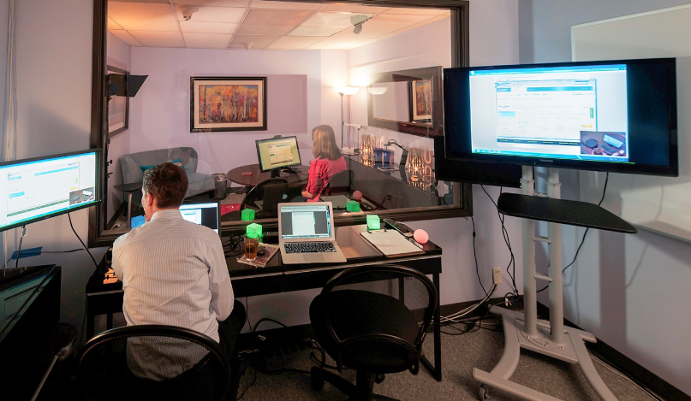
Core elements of usability testing
Digital Product
Participant
Task Sheets
Facilitator’s laptop & external monitor
Facilitator
Notes:
In this usability-test session, the participant sits on the right, and the facilitator sits on the left. The participant uses a special testing laptop, which is running screen-recording software. The laptop has a webcam to capture the participant’s facial expressions and is connected to an external monitor for the facilitator. The facilitator listens to her feedback, administers tasks, and takes notes.

Slide 14


A 3-dimensional framework of UX research methods
What people do
Context of Product Use
Behavioural
State of believe / What people say
Attitudinal
Qualitative (Direct)
Quantitative (Indirect)
Why & how to fix
How many & how much
Notes:
The field of user experience has a wide range of research methods available.
To better understand when to use which method, it is helpful to view them along a 3-dimensional framework:
Attitudinal vs. Behavioural
Qualitative vs. Quantitative
Context of Product Use
Attitudinal vs. Behavioural
The purpose of attitudinal research is usually to understand or measure people's stated beliefs, but it is limited by what people are aware of and willing to report.
While behavioural studies pay attention to what users do, watch users as they attempt to perform tasks with the user interface, not what they say. Self-reported claims are unreliable, as are user speculations about future behaviour. Users do not know what they want.
Qualitative vs. Quantitative
Studies that are qualitative in nature generate data about behaviours or attitudes based on observing or hearing users directly that help to identify design features easy or hard to use. Analysis of the data is usually not mathematical.
Whereas in quantitative studies, the data about the behaviour or attitudes in question are gathered indirectly, through a measurement or an instrument such as a survey or an analytics tool that help collect data, in form of one or more metrics (such as task completion rates or task times) that reflect whether the tasks were easy to perform.

Slide 15
Types of Usability Testing - data
Qualitative usability testing focuses on:
  collecting insights, findings, and anecdotes about how people use the product or service.
  discovering problems in the user experience.
  This form of usability testing is more common than quantitative usability testing.
Quantitative usability testing focuses on:
  collecting metrics that describe the user experience.
  Two of the metrics most commonly collected in quantitative usability testing are task success and time on task.
  Quantitative usability testing is best for collecting benchmarks.

Slide 16
A landscape of User Research Methods
Behavioural
Eye tracking
Clickstream Analytics
Usability Testing
Usability Benchmarking
Remote Moderated Testing
A/B Testing
Field studies
Unmoderated Testing
Contextual Inquiry
Concept Testing
Diary Studies
Participatory Design
Card Sorting/
Tree Testing
Attitudinal
Focus Groups
Customer Feedback
Desirability Studies
Surveys
Interviews
Qualitative (direct)
Quantitative (indirect)
Natural Use of the product
Decontextualised/not using product
Scripted (often lab-based) use of product
Limited use of product
Notes:
Natural use of product
Field Studies Researchers study participants in their own environment (work or home), where they would most likely encounter the product or service being used in the most realistic or natural environment.
Contextual Inquiry Researchers and participants collaborate together in the participants own environment to inquire about and observe the nature of the tasks and work at hand
Diary Studies Participants are given a mechanism (diary or camera) to record and describe aspects of their lives that are relevant to a product or service or simply core to the target audience. Diary studies are typically longitudinal and can be done only for data that is easily recorded by participants.
Customer Feedback Open-ended and/or close-ended information provided by a self-selected sample of users, often through a feedback link, button, form, or email.
Eyetracking An eyetracking device is configured to precisely measure where participants look as they perform tasks or interact naturally with websites, applications, physical products, or environments.
Clickstream Analytics A particular type of analytics that involves analyzing the sequence of pages that users visit as they use a site or software application.
A/B Testing A method of scientifically testing different designs on a site by randomly assigning groups of users to interact with each of the different designs and measuring the effect of these assignments on user behavior.
Scripted (often lab-based) use of product
Usability Testing Participants are brought into a lab, one-on-one with a researcher, and given a set of scenarios that lead to tasks and usage of specific interest within a product or service.
Remote Moderated Testing Usability studies conducted remotely, with the use of tools such as video conferencing, screen-sharing software and remote-control capabilities.
Usability Benchmarking Tightly scripted usability studies are performed with several participants, using precise and predetermined measures of performance.
Unmoderated Testing An automated method that can be used in both quantitative and qualitative studies and that uses a specialized research tool to capture participant behaviors and attitudes, usually by giving participants goals or scenarios to accomplish with a site, app, or prototype.
Decontextualized / not using product
Focus Groups Groups of 3–12 participants are led through a discussion about a set of topics, giving verbal and written feedback through discussion and exercises.
Interviews A researcher meets with participants one-on-one to discuss in depth what the participant thinks about the topic in question.
Surveys A quantitative measure of attitudes through a series of questions, typically more closed-ended than open-ended.
Limited use of product
Participatory design: Participants are given design elements or creative materials in order to construct their ideal experience in a concrete way that expresses what matters to them most and why.
Concept Testing A researcher shares an approximation of a product or service that captures the key essence (the value proposition) of a new concept or product in order to determine if it meets the needs of the target audience. It can be done one-on-one or with larger numbers of participants, and either in person or online.
Card Sorting A quantitative or qualitative method that asks users to organize items into groups and assign categories to each group. This method helps create or refine the information architecture of a site by exposing users’ mental models.
Desirability Studies Participants are offered different visual-design alternatives and are expected to associate each alternative with a set of attributes selected from a closed list. These studies can be both qualitative and quantitative.

Slide 17
What methods?
It depends at what stage of the SDLC
  Concept generation & ideation
    If you are looking to understand human behaviour or identify issues with a current system design that will show directions for a new solution
  Iteration & evaluation
    If you are testing the effect of an update of a design & evaluation
  What data we want to collect

Slide 18




Methods for testing usability
Type of data
Location
Qualitative
Remote
In-Person
Quantitative
Presence of moderator
Moderated
Unmoderated
Behavioural
Attitudinal
Performance
Preference
Does it do what we want it to achieve?
Iteration & evaluation
UCD

Slide 19
Quantitative (Qual) vs.
Qualitative (Quant) Usability Testing
All usability testing studies involve a participant performing some assigned tasks on one or more designs. There are, however, two types of data that can be collected in a user-testing study:
  Qualitative (qual) data, consisting of observational findings that identify design features easy or hard to use
  Quantitative (quant) data, in form of one or more metrics (such as task completion rates or task times) that reflect whether the tasks were easy to perform
Notes:
Qual Research
Qualitative data offer a direct assessment of the usability of a system: researchers will observe participants struggle with specific UI elements and infer which aspects of the design are problematic and which work well. They can always ask participants followup questions and change the course of the study to get insights into the specific issue that the participant experiences. Then, based on their own UX knowledge and possibly on observing other participants encounter (or not) the same difficulty, researchers will determine whether the respective UI element is indeed poorly designed.
Quant Research
Quantitative data offer an indirect assessment of the usability of a design. They can be based on users’ performance on a given task (e.g., task-completion times, success rates, number of errors) or can reflect participants’ perception of usability (e.g., satisfaction ratings). Quantitative metrics are simply numbers, and as such, they can be hard to interpret in the absence of a reference point. For example, if 60% of the participants in a study were able to complete a task, is that good or bad? It’s hard to say in the absolute. That is why many quant studies usually aim not so much to describe the usability of a site, but rather to compare it with a known standard or with the usability of a competitor or a previous design.
While quant data can tell us that our design may not be usable relative to a reference point, they do not point out what problems users encountered. Even worse, they don’t tell us what changes to make in the design to get a better result next time. Knowing that only 40% of the participants are able to complete a task doesn’t say why users had trouble with that task or how to make it easier. Often researchers will need to use qual methods to supplement quant data in order to understand the specific usability issues in an interface.
Statistical Significance
One advantage of quant over qual is statistical significance. When quant data are presented in a sound way, they come with a certain protection against randomness: usually, mathematical instruments such as confidence intervals and statistical significance will tell us how likely it is that the data reflect the truth or whether they may be just an effect of random noise — perhaps an artifact of the specific participants that we happened to recruit or of the conditions in which the study was run. Although seasoned qual researchers will deploy an arsenal of good practices to protect themselves from chance and to make sure that their results are not biased, we have no formal assurance that the findings from a qual study are indeed objective and representative for the whole target population.

Slide 20
Differences between Qual and Quant
Qual vs Quant
  different study setups and very different analysis methods
  they are rarely collected at the same time
Notes:
Both qualitative and quantitative testing are essential in the iterative design cycle. Although qual studies are more common in our industry, quant studies are the only ones that allow us to put a number on a redesign and clearly say how much our new version improved over the old one — they are the essential instrument in calculating return on investment.

Slide 21
When to use Qual and Quant
 | Qual Research | Quant Research
Questions answered | Why? | How many and how much?
Goals | Both formative and summative: inform design decisions identify usability issues and find solutions for them | Mostly summative: evaluate the usability of an existing site track usability over time compare site with competitors compute ROI (Return on Investment)
When it is used | Anytime: during redesign, or when you have a final working product | When you have a working product (either at the beginning or end of a design cycle)
Outcome | Findings based on the researcher’s impressions, interpretations, and prior knowledge | Statistically meaningful results that are likely to be replicated in a different study
Methodology | Few participants Flexible study conditions that can be adjusted according to the team’s needs Think-aloud protocol | Many participants Well-defined, strictly controlled study conditions Usually no think-aloud
Notes:
The table summarizes the differences between the two types of research.
The Iterative Design Cycle: Goals for Qual vs. Quant
The basic user-centered design cycle starts with an evaluation of an existing design, followed by a redesign intended to address the current system’s usability challenges. Once the new version is complete, it can be evaluated and compared against the initial version.
The iterative design cycle: Steps 1 and 3 involve summative research (done with either quantitative or qualitative methods), while step 2 involves formative research (done with qualitative methods). The first and third stage of the iterative design cycle are summative — they are intended to provide an overall assessment of a design. In these steps both qual and quant research methods (or combinations such as PURE) can be used to evaluate the design. However, when the goal is to link the entire redesign effort to actual financial savings or explicitly figure out how much the redesign has improved, quant studies must be used. Organizations with mature UX often have such a quant usability-tracking process in place. (Sometimes this process of quantitatively evaluating each version of a design and comparing it with previous versions is called benchmarking.)
During the redesign stage, user research has a formative role: it is meant to inform the design and steer it on the right path. In this phase, designers and researchers need to get user data relatively quickly and cheaply in order to be able to choose among different design alternatives and create a usable UI. At this stage, qual studies are usually the most appropriate. We know that, with 5 users, a qualitative study is likely to uncover 85% of the usability problems in a design (provided that the design is not already close to being perfect), so, in the redesign step, it makes sense to run one quick study with a few users, determine the big issues, fix them, and then test the new version again with another small set of users.
When to Use Qual vs. Quant
Qual studies are well suited for identifying the main problems in a design: for example, we can easily run a qualitative study to see what (if anything) prevents users from submitting a form successfully, and, based on that study, we may determine that we need to lengthen the form fields, present password requirements, or use labels outside the fields rather than inside them.
In contrast, most quant studies are done on a complete version of the site, with the purpose of evaluating the usability of the site, rather than directly informing the redesign process. This is not because one could not employ quantitative methods during the redesign iterations, but rather because quant usability studies would be too costly if used often and early in the design process. Quant studies usually involve a large number of users, and most organizations cannot afford to spend a lot of money on such studies to investigate whether the page copy is clear or whether a button is findable. However, the numbers obtained from quantitative testing can be invaluable when it comes to convincing upper management that your site is in need of a complete redesign.
Outcome: Qual vs. Quant
Qual data usually will consist of a set of findings, which identify (and prioritize according to severity) the strengths and weaknesses of a design. These findings are estimates — they are based on the knowledge and level of experience of the researcher facilitating the task and interpreting the meanings of the users’ actions. Different practitioners will often identify different issues in the same user-testing session (a phenomenon known as the evaluator’s effect). Plus, even if we’ve been very careful in recruiting participants who match our target demographics, when we include only a few people there is always a chance that they are not truly representative of the whole user population, and so our findings may be skewed.
Quant studies usually involve a relatively large number of users (often more than 30) and use statistical techniques to protect themselves against such random events. When reported correctly, quantitative studies will include information about the statistical significance of the results. For example, a margin of error will help you understand how much you can trust the results from the study. Or, if the difference in task-completion time between your site and the competitor’s site was statistically significant, you will know that, even if you were to recruit a different set of users and rerun your study, your results will point in the same direction, even if the exact averages may be slightly different.
Thus, when quantitative studies are carried out and analyzed correctly, you can have confidence that their results are sound. Namely, that they are not due to a lucky or unlucky throw of the dice.
These types of analyses are based on statistics and usually involve other types of skills than you will find in a qual usability researcher. That is why many companies have separate job requirements for quant and qual UX researchers.
Methodology: Qual vs. Quant
On the surface quantitative and qualitative user testing can look quite similar (i.e., they both involve users performing tasks on a design). Both types of studies need to follow the basic rules for good experiment design, by making sure that they have:
External validity: participants are representative of the target audience and the study conditions reflect how the task is done in the wild. For instance, testing a mobile site on a desktop simulator lacks external validity because people would normally use that site on a touchscreen phone.
Internal validity: the experiment setup does not favor any one condition. For example, if design A is tested in the morning and design B is tested in the afternoon, it is possible that fatigue play a role in how participants use design B.

Slide 22
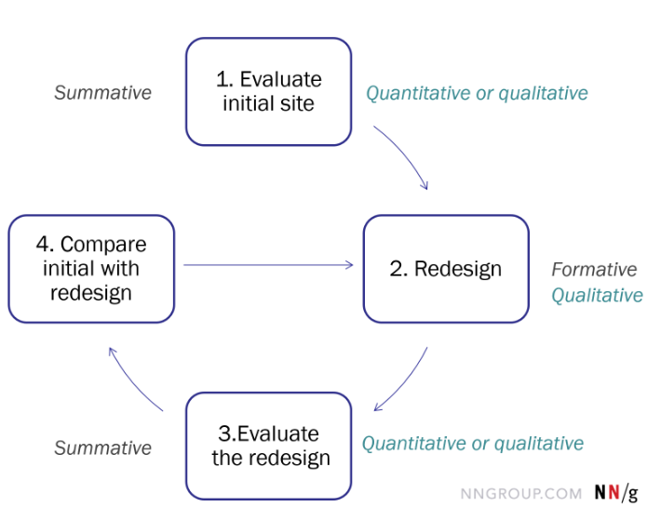
Goals of Qual and Quant in iterative design cycle
Notes:
The first and third stage of the iterative design cycle are summative — they are intended to provide an overall assessment of a design. In these steps both qual and quant research methods (or combinations such as PURE) can be used to evaluate the design.
However, when the goal is to link the entire redesign effort to actual financial savings or explicitly figure out how much the redesign has improved, quant studies must be used.
During the redesign stage, user research has a formative role: it is meant to inform the design and steer it on the right path. In this phase, designers and researchers need to get user data relatively quickly and cheaply in order to be able to choose among different design alternatives and create a usable UI. At this stage, qual studies are usually the most appropriate.
We know that, with 5 users, a qualitative study is likely to uncover 85% of the usability problems in a design (provided that the design is not already close to being perfect), so, in the redesign step, it makes sense to run one quick study with a few users, determine the big issues, fix them, and then test the new version again with another small set of users.

Slide 23
Validity of Qual vs. Quant
Both qual & quant studies need to follow certain rules of good experimental design making sure they have:
  External validity
    The users are representative
    The conditions map reality (test a mobile app on a desktop simulation, or test a TV set in a lab)
  Internal validity
    The experiment does not favour any one condition (testing a digital product with group A in the morning and with group B in the afternoon, it is possible that fatigue plays a role in how participants use design B)
Notes:
External validity: participants are representative of the target audience and the study conditions reflect how the task is done in the wild. For instance, testing a mobile site on a desktop simulator lacks external validity because people would normally use that site on a touchscreen phone.
Internal validity: the experiment setup does not favour any one condition. For example, if design A is tested in the morning and design B is tested in the afternoon, it is possible that fatigue play a role in how participants use design B.

Slide 24


Types of Usability Testing - location
In-person - as the name suggests, requires the test to be completed in the physical presence of a UX researcher/moderator
  Pros - in-person tests provide extra data points (body language and facial expressions)
  Cons - cost
Remote - tests are done over the internet or by phone
  Cons - Remote testing doesn’t go as deep into a participant’s reasoning
  Pros - it allows you to test large numbers of people in different geographical areas using fewer resources
In-person vs Remote
  Does the method of testing benefit more from remote or in-person?
  Are context, setting, and environment important factors?
Notes:
Remote usability tests are done over the internet or by phone; in-person testing, as the name suggests, requires the test to be completed in the physical presence of a UX researcher/moderator.
Compared to remote tests, in-person tests provide extra data points, since researchers can observe and analyze body language and facial expressions. However, in-person testing is usually expensive and time-consuming: you have to find a suitable space, block out a specific date, and recruit (and pay) participants.
Remote testing doesn’t go as deep into a participant’s reasoning, but it allows you to test large numbers of people in different geographical areas using fewer resources.
Remote or in-person testing. What method is better? Well, this depends on several factors.
One, does the method of testing you're using benefit more from remote or in-person?
Two, could the context, setting, and environment play an important factor in what you learn?
In the example of a study of a cyber defense program, it was very difficult to get access to the military and government professionals that would be our users. It was even harder to gain access on-site due to security and privacy. To make matters even more challenging, we were limited to recording pictures, video, or sound. Sometimes it was off-limits completely. Had we given up, so to speak, and figured out how to perform them remotely, we would have missed several important discoveries. The fancy equipment we see on TV in the movies is rare. Rather, the norm is small, low resolution laptop screens and rooms lit by bad overhead fluorescent lights. These observations, environmental factors, and technology limits we discovered profoundly reshaped how we thought about typography, color, contrast in interactions within the UI.
In the past, remote observation was extremely limited. Much of it was simply a lack of access to a computer, camera, microphone, and a high-speed internet connection. Some of it was limitations as to what we could see, such as their face, body language, and screen activity. Today, many people have computers, and even our mobile phones have sophisticated cameras and microphones. Plus many of us have a high-speed internet connection. In addition to that, there are platforms and technologies designed for remote user testing. Some of these even have integrated services for surveying and recruiting participants.
Today you have to worry less about remote or in-person due to technical constraints. Rather, consider whether the method of testing you are using benefits from being remote or in-person. Then examine your goals, what you hope to learn, to determine if context, setting, and environment may be an important factor. If those appear unimportant, make sure you have a firm grasp on what those environmental factors are before proceeding without that knowledge and guidance.

Slide 25

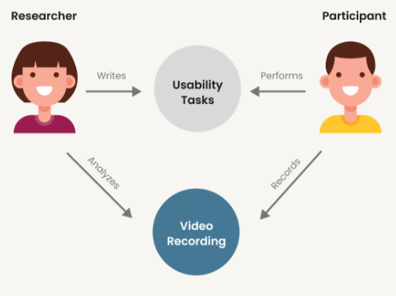
Types of Usability Testing – moderator’s presence
Moderated
Unmoderated
A moderated testing session is administered in-person or remotely by a trained researcher who introduces the test to participants, answers their queries, and asks follow-up questions.
An unmoderated test is done without direct supervision, participants might be in a lab, or at home and/or using their own devices to interact with the digital system that is being tested.
Notes:
A moderated testing session is administered in person or remotely by a trained researcher who introduces the test to participants, answers their queries, and asks follow-up questions. Conversely, an unmoderated test is done without direct supervision; participants might be in a lab, but it's more likely they are in their own homes and/or using their own devices to browse the website that is being tested.
Moderated testing usually produces in-depth results thanks to the direct interaction between researchers and test participants, but can be expensive to organize and run (e.g., securing a lab, hiring a trained researcher, and/or providing compensation for the participants). The cost of unmoderated testing is lower, though participant answers can remain superficial and follow-up questions are impossible.
As a general rule of thumb, use moderated testing to investigate the reasoning behind user behavior, and unmoderated testing to test a very specific question or observe and measure behavior patterns.
Moderated or unmoderated testing, what method is better? Well, this depends on several factors.
One, does the method of testing you're using benefit more from moderated or unmoderated?
Two, does the ability to moderate the testing play an important factor in what you learn?
Sometimes, moderating the testing seems unimportant to what you may learn from unmoderated observation.
When you moderate testing, you are there or someone else to facilitate the testing. You use the same exact format with everyone, but you use a moderator's guide to ask questions and probe deeper depending on the response of the individual participants. When you're not there, we call it unmoderated.
Common forms of unmoderated testing methods are contextual inquiries, usability testing, and participatory design. These methods are performed much like an interview or a live test where it is important that the participants are guided through the activity, and you can ask further questions as necessary. An example of a strategy for moderated testing involves asking them why five times. It's a common way in business as well to get down to the root problem or cause.
A user survey is a kind of testing that's often unmoderated. It's essentially a form that the participants fill out on their own.
Another methodology that can be performed unmoderated is a card sort. A card sorts a user research method in which study participants group individual labels written on note cards or using a web tool or app according to the criteria that makes sense to them. Okay, imagine you're using a card sort as your testing method, and you're trying to learn how people organize their music. You want to see how they think about songs, albums, artists, bands, genres, playlists, and so on. You're hoping to understand how people mentally organize and process their music collections as well as how they categorize while consuming them. In an unmoderated and a moderated card sort, you'll get to see the results of how each individual sorts and groups the cards. And you can use those outcomes to compare and contrast and even create groups of like sorts. But what might you gain by moderating and lose by, well, not being there to guide them? By moderating, you gain what I like to call the in-betweens, meaning all those moments before they come up with the final grouping. All those thoughts is they rethink or change their minds. When you're there, you can notice those and politely stop and ask them what they are thinking and why they might be changing something. Perhaps they actually have two ways both of which they prefer for different reasons and situations. Wouldn't it be great to know that? To have that understanding in some cases can be crucial to designing the perfect solution. For example, maybe you find that when listening to well-known music, most people group their music by song title, while unknown music is more often organized by artist and album. See how knowing and understanding why people do that could help you design a solution that pleases both types of organization, thereby creating a more encompassing solution.

Slide 26
When to Use Moderated Usability Testing
Exploratory testing: When you want to gain deep insights into user behaviour, mental models, and preferences.
Complex interfaces or products: When the tasks involve complicated workflows that might confuse users.
Early-stage testing: For testing prototypes where user behavior needs close observation.
Probing and real-time feedback: When you want to ask "why" questions and gather qualitative data on frustrations or preferences.

Slide 27
When to Use Unmoderated Usability Testing
Scale: When testing with many users or geographically dispersed participants.
Late-stage testing: When the product is more polished and you want to measure how easily users complete tasks without help.
Natural behaviour: When you want users to engage with the product in their natural environment, providing real-world insights.
Time and cost efficiency: When resources are limited and quick feedback is needed.

Slide 28
Types of Usability Testing – moderator’s presence
A moderated test
  Pros - produces in-depth results thanks to the direct interaction between researchers and test participants
  Cons - expensive to organize and run (e.g., securing a lab, hiring a trained researcher, and/or providing compensation for the participants).
  It is important to
    Use the same format with everyone (meaning all users)
    Use a moderators guide to ask questions
    Probe deeper on responses (Why why why why why (5 x why))
An unmoderated test
  Pros - the cost of unmoderated testing is lower
  Cons - participant answers can remain superficial and follow-up questions are impossible
      Methods that can be used involve
    Contextual inquiries (surveys)
    Usability testing
    Card shorting
Notes:
A moderated testing session is administered in person or remotely by a trained researcher who introduces the test to participants, answers their queries, and asks follow-up questions. Conversely, an unmoderated test is done without direct supervision; participants might be in a lab, but it's more likely they are in their own homes and/or using their own devices to browse the website that is being tested.
Moderated testing usually produces in-depth results thanks to the direct interaction between researchers and test participants, but can be expensive to organize and run (e.g., securing a lab, hiring a trained researcher, and/or providing compensation for the participants). The cost of unmoderated testing is lower, though participant answers can remain superficial and follow-up questions are impossible.
As a general rule of thumb, use moderated testing to investigate the reasoning behind user behavior, and unmoderated testing to test a very specific question or observe and measure behavior patterns.
Moderated or unmoderated testing, what method is better? Well, this depends on several factors.
One, does the method of testing you're using benefit more from moderated or unmoderated?
Two, does the ability to moderate the testing play an important factor in what you learn?
Sometimes, moderating the testing seems unimportant to what you may learn from unmoderated observation.
When you moderate testing, you are there or someone else to facilitate the testing. You use the same exact format with everyone, but you use a moderator's guide to ask questions and probe deeper depending on the response of the individual participants. When you're not there, we call it unmoderated.
Common forms of unmoderated testing methods are contextual inquiries, usability testing, and participatory design. These methods are performed much like an interview or a live test where it is important that the participants are guided through the activity, and you can ask further questions as necessary. An example of a strategy for moderated testing involves asking them why five times. It's a common way in business as well to get down to the root problem or cause.
A user survey is a kind of testing that's often unmoderated. It's essentially a form that the participants fill out on their own.
Another methodology that can be performed unmoderated is a card sort. A card sorts a user research method in which study participants group individual labels written on note cards or using a web tool or app according to the criteria that makes sense to them. Okay, imagine you're using a card sort as your testing method, and you're trying to learn how people organize their music. You want to see how they think about songs, albums, artists, bands, genres, playlists, and so on. You're hoping to understand how people mentally organize and process their music collections as well as how they categorize while consuming them. In an unmoderated and a moderated card sort, you'll get to see the results of how each individual sorts and groups the cards. And you can use those outcomes to compare and contrast and even create groups of like sorts. But what might you gain by moderating and lose by, well, not being there to guide them? By moderating, you gain what I like to call the in-betweens, meaning all those moments before they come up with the final grouping. All those thoughts is they rethink or change their minds. When you're there, you can notice those and politely stop and ask them what they are thinking and why they might be changing something. Perhaps they actually have two ways both of which they prefer for different reasons and situations. Wouldn't it be great to know that? To have that understanding in some cases can be crucial to designing the perfect solution. For example, maybe you find that when listening to well-known music, most people group their music by song title, while unknown music is more often organized by artist and album. See how knowing and understanding why people do that could help you design a solution that pleases both types of organization, thereby creating a more encompassing solution.

Slide 29
Key Differences: Moderated vs Unmoderated Usability Test
Aspect | Moderated Usability Test | Unmoderated Usability Test
Facilitation | Facilitator present to guide users | No facilitator; users complete tasks alone
Interaction | Real-time interaction and guidance | No real-time interaction
Environment | Typically in a lab or online with facilitator | Typically remote, in the user's natural environment
Feedback | Immediate, detailed, qualitative feedback | Delayed, quantitative feedback
Cost | More expensive due to facilitator and setup | Cost-effective for large-scale testing
Best For | Early-stage, exploratory testing | Large-scale, late-stage testing
Notes:
So whether you perform your testing moderated or unmoderated, although it comes down to several factors, it really boils down to two considerations. Does the method of testing you're using benefit more from moderated or unmoderated? Does the ability to moderate the testing play an important factor in what you learn? Understanding these and giving them some careful consideration guides you towards selecting what will give you the most helpful knowledge and understanding of your customers. Knowing the trade-offs will lead you towards making the best decisions for the next steps.

Slide 30
Usability testing methods
REMOTE
Phone/Video Interview
Session Recordings
USER TESTING PLATFORMS
MODERATED
UNMODERATED
Lab Usability testing
Querrilla Testing
Observation
IN-PERSON
Notes:
Each usability testing method gives answers to your research questions. The method you choose will depend on both your resources and your objectives.

Slide 31
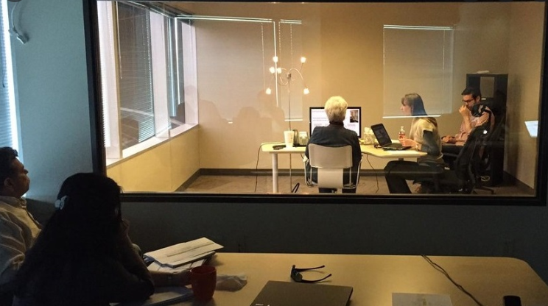
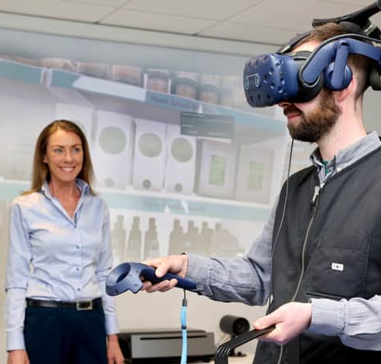
Moderated + in-person usability testing
Lab usability testing
  Test takes place in a specially built usability testing lab
  Test subjects complete tasks while a trained moderator observes and asks questions
  Stakeholders can also watch the proceedings and take notes behind a one-way mirror in the testing area
  Pros - control - all sessions are run under the same standardised conditions, which makes it especially useful for comparison tests
  Cons – cost - these tests are expensive and usually based on small population size (8-10 participants per research round) in a controlled environment, which is not necessarily reflective of your actual use base and/or real-life use conditions.
Notes:
This type of usability research takes place inside a specially built usability testing lab. Test subjects complete tasks on computers/mobile devices while a trained moderator observes and asks questions. Typically, stakeholders also watch the proceedings and take notes behind a one-way mirror in the testing area.
A major benefit of lab usability testing is the control it provides: all sessions are run under the same standardized conditions, which makes it especially useful for comparison tests. However, these tests are expensive and usually based on a small population size (8-10 participants per research round) in a controlled environment, which is not necessarily reflective of your actual customer base and/or real-life use conditions.

Slide 32
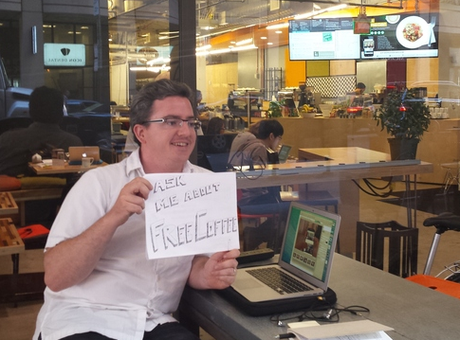
Moderated + in-person usability testing
Guerrilla testing
  Test subjects are chosen at random from a public place, usually a coffee shop, mall, or airport. They are asked to perform a quick usability test, often in exchange for a gift card or other incentive.
  Pros:
    Test a wide cross-section of people who may have no history with a product.
    Offer a quick way to collect large amounts of data that validate certain design elements or functionality
  Cons - not a good method for extensive testing or follow-ups, as people are usually reluctant or unable to give up more than 5-10 minutes of their time.
Notes:
Guerrilla testing
In guerrilla testing, test subjects are chosen at random from a public place, usually a coffee shop, mall, or airport. They are asked to perform a quick usability test, often in exchange for a gift card or other incentive.
Guerrilla testing is used to test a wide cross-section of people who may have no history with a product. It's a quick way to collect large amounts of qualitative data that validate certain design elements or functionality—but it's not a good method for extensive testing or follow-ups, as people are usually reluctant or unable to give up more than 5-10 minutes of their time.

Slide 33
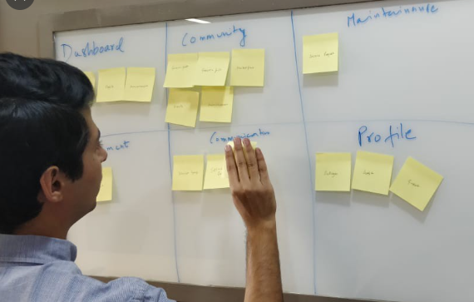
Moderated + remote usability testing
Phone interviews - a moderator verbally instructs participants to complete tasks on their computer and collects feedback while the user's electronic behaviour is recorded remotely.
  Pros - an economical way to test users in a wide geographical area
  Pros - help collect more data in a shorter period.
Card sorting involves placing concepts on virtual note cards and allowing participants to manipulate the cards into groups and categories. After they sort the cards, they explain their logic in a moderator-run debriefing session.
  Pros - a great method to get feedback about layout and navigational structure.
  It shows designers and product managers how people and potential customers naturally organize information, which can help make a product (website) more intuitive to navigate.
Notes:
# Phone interviews
In a phone usability test, a moderator verbally instructs participants to complete tasks on their computer and collects feedback while the user's electronic behavior is recorded remotely.
Phone interviews are an economical way to test users in a wide geographical area. Because they are less expensive than in-person interviews, they help collect more data in a shorter period.
# Card sorting
Card sorting involves placing concepts on virtual note cards and allowing participants to manipulate the cards into groups and categories. After they sort the cards, they explain their logic in a moderator-run debriefing session.
Card sorting is a great method for both new and existing websites to get feedback about layout and navigational structure. Its results show designers and product managers how people and potential customers naturally organize information, which can help make a site more intuitive to navigate.

Slide 34
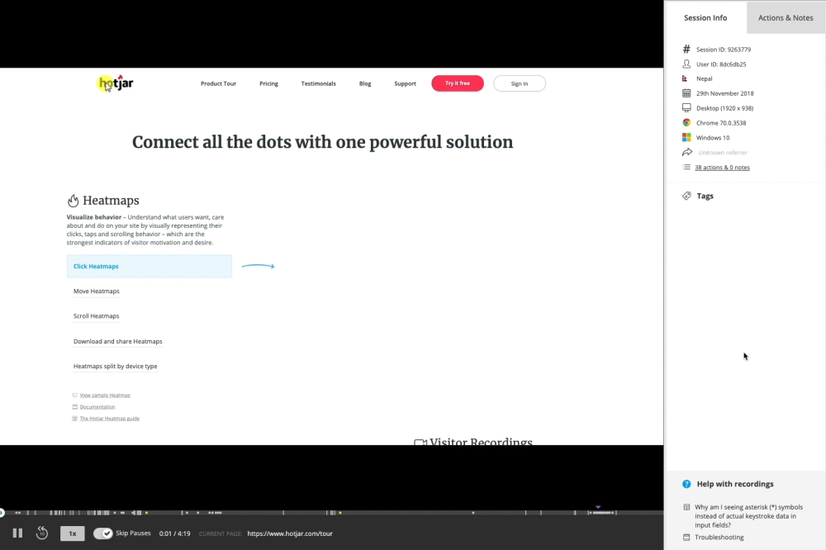
Unmoderated + remote
Session recordings use software to record the actions that “real” people take on a digital product such as mouse clicks, movement, and scrolling.
Pros - spot major problems with the intended functionality of the digital product, watch how people interact with its UI elements such as menus and Calls-to-Action (CTAs), and see places where they stumble, u-turn (go back to a previous page quickly after landing on a new one), or completely leave.
Notes:
Session recordings use software to record the actions that real (but anonymized) people take on a website such as mouse clicks, movement, and scrolling. Session recordings are a fantastic way to spot major problems with a site's intended functionality, watch how people interact with its page elements such as menus and Calls-to-Action (CTAs), and see places where they stumble, u-turn (go back to a previous page quickly after landing on a new one), or completely leave.

Slide 35
Unmoderated + in-person
Observation - the researchers watch participants run through a set of instructions in a lab, but they do not participate. They may interject if a participant gets stuck, but otherwise, they remain quiet and concentrate on taking notes.
Pros – it allows researchers to see the body language and facial expressions of participants without interference from a moderator.
Notes:
In this sort of test, the researchers watch but don't participate, acting as a sort of ‘fly on the wall’ as participants run through a set of instructions in a lab. They may interject if a participant gets stuck, but otherwise, they remain quiet and concentrate on taking notes.
Observation testing allows researchers to see the body language and facial expressions of participants without interference from a moderator.
where they stumble, u-turn (go back to a previous page quickly after landing on a new one), or completely leave.

Slide 36
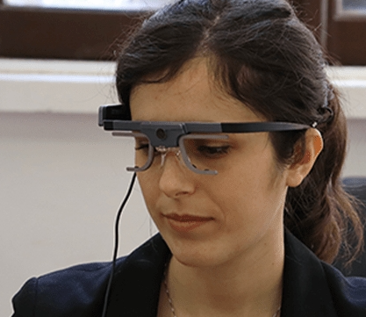
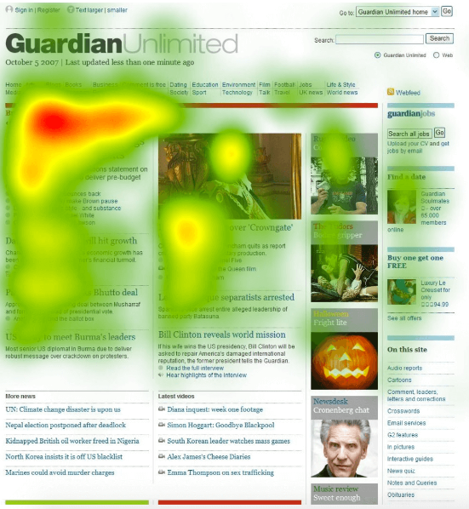
Unmoderated + in-person
Eye-tracking tests - researchers observe and study users' eye movements using a special pupil-tracking device mounted on a computer.
The machine/software creates heatmaps or movement pathway diagrams based on where users focus their attention.
Pros – we can understand how users interact visually with a page and this can help to test the UI, the layout and design elements of a page, identify what may be distracting or taking someone's focus away from the main page elements.
Cons- cost - eye-tracking studies require a lab with special equipment and dedicated software (plus a trained technician who can help you calibrate the device).
Notes:
During eye-tracking tests, researchers observe and study users' eye movements using a special pupil-tracking device mounted on a computer. By analyzing where users direct their attention when asked to complete a task, the machine can create heatmaps or movement pathway diagrams.
Eye-tracking studies can be used to glean information about how users interact visually with a page; they also help test layout and design elements and see what may be distracting or taking someone's focus away from the main page elements. The downside? Cost: an eye-tracking study requires you to rent a lab with special equipment and dedicated software (plus the trained technician who can help you calibrate the device).

Slide 37
Unmoderated + remote
Software - here are some of the most common tools/software that facilitate online testing :
  Remote usability testing tools and software
  Unmoderated card sorting
  First-click

Slide 38
Recap
Where usability testing fits in the SDLC
Building in usability in UCD
Testing usability
How we decide what usability testing methods to use based on what we want to achieve
Classification of Usability testing methods based on:
  Data type – qual, quant
  Location
  How they are facilitated
Next week – understand data types

Slide 39
Test your understanding
What are the benefits of usability testing?
How we gather information about usability during the following stages of the SDLC:
  Ideation
  Iteration and & evaluation
What types of data we can collect with usability testing?
When do we need to conduct qual vs quant usability testing? And why?
When do we conduct moderated vs unmoderated usability testing? And why?
When do we conduct in-person vs remote usability testing? And why?
Find 2 web-based open-source sites you could use for remote moderated testing, what data it allows you to collect and in what format?
Find 1 web-based open-source site you could use for remote un-moderated testing, what data it allows you to collect and in what format?

Slide 40
Reading
Carol M. Barnum (2020) Usability testing essentials, Ready, Set... Test!, Morgan Kaufmann.
  Chapter 1, Establishing the essentials
  Chapter 2 Testing here, there, everywhere
Rubin, J. & Chisnell, D. (2008) Handbook of usability testing: how to plan, design, and conduct effective tests, second edition. 2nd ed. Indianapolis, Ind: Wiley.
  Chapter 1. What Makes Something Usable?
  Chapter 2. What Is Usability Testing?
  Chapter 3. When should you Test?
Online Resources
  When to Use Which User-Experience Research Methods
  https://www.nngroup.com/articles/which-ux-research-methods/
  Usability 101: Introduction to Usability
    https://www.nngroup.com/articles/usability-101-introduction-to-usability/
  Usability Testing 101
    https://www.nngroup.com/articles/usability-testing-101/
  Quantitative vs. Qualitative Usability Testing
    https://www.nngroup.com/articles/quant-vs-qual/
  Benchmarking UX: Tracking Metrics
    https://www.nngroup.com/articles/benchmarking-ux/

